Slide 1
1. Basic international food
RAINBOW OF EDUCATION
PowerPoint Presentations

Slide 2
noodles

Slide 3
rice

Slide 4
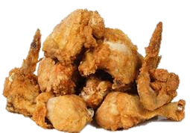
chicken

Slide 5
sandwich

Slide 6
salad

Slide 7
fish

Slide 8
egg

Slide 9
soup

Slide 10
pork

Slide 11
beef

Slide 12
potato

Slide 13
French fries

Slide 14
NOW, LET’S EXERCISE

Slide 15
rice

Slide 16
noodles

Slide 17
chicken

Slide 18
sandwich

Slide 19
salad

Slide 20
pork

Slide 21
fish

Slide 22
egg

Slide 23
soup

Slide 24
beef

Slide 25
French fries

Slide 26
potato

Slide 27
2. fruits

Slide 28
apple

Slide 29
grapes

Slide 30
mango

Slide 31
watermelon

Slide 32
pear

Slide 33
banana

Slide 34
cherry

Slide 35
strawberry

Slide 36
orange

Slide 37
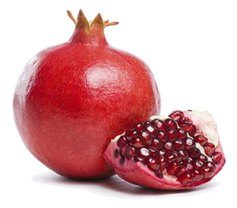
pomegranate

Slide 38
NOW, LET’S EXERCISE

Slide 39
mango

Slide 40
orange

Slide 41
pomegranate

Slide 42
strawberry

Slide 43
cherry (cherries)

Slide 44
banana

Slide 45
pear

Slide 46
watermelon

Slide 47
grapes

Slide 48
apple

Slide 49
Vegetables

Slide 50
tomato

Slide 51
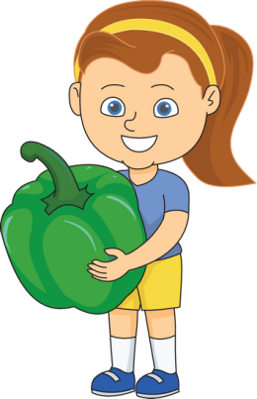
paprika

Slide 52
carrot

Slide 53
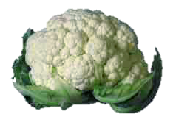
cauliflower

Slide 54
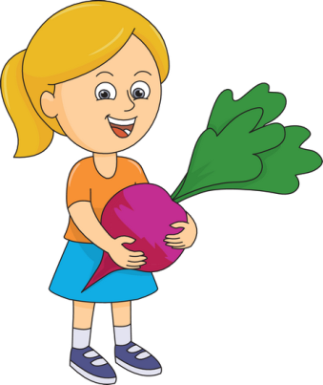
beetroot

Slide 55
pumpkin

Slide 56
eggplant

Slide 57
maize

Slide 58
cucumber

Slide 59
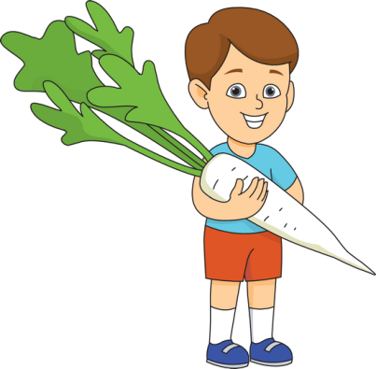
radish

Slide 60
NOW, LET’S EXERCISE

Slide 61
tomato

Slide 62
pumpkin

Slide 63
eggplant

Slide 64
paprika

Slide 65
cauliflower

Slide 66
carrot

Slide 67
maize

Slide 68
beet

Slide 69
radish

Slide 70
cucumber

