Slide 1
Directions and City Orientation
RAINBOW OF EDUCATION
PowerPoint Presentations

Slide 2
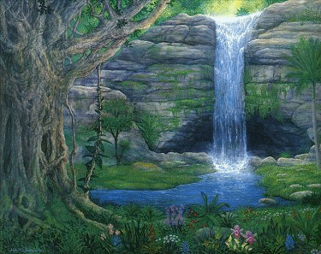
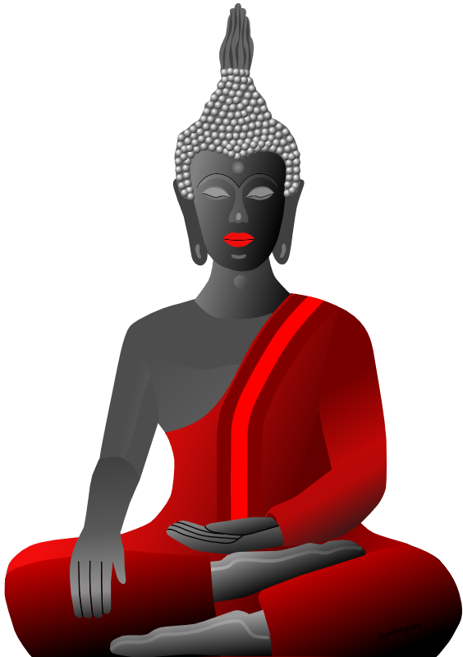
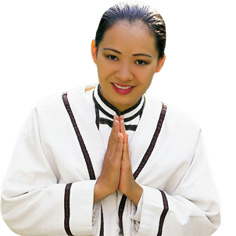
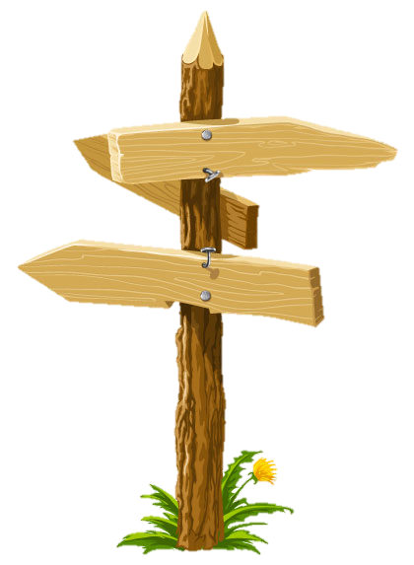
Welcome to
Chiang Mai
Doi Suthep
Chiang Mai Zoo

Slide 3
Prepositions of Place

Slide 4
moving or not moving
The ball is rolling
The ball is on the ground.
Not moving / stationary

Slide 5
around

Slide 6
over

Slide 7
on

Slide 8
under

Slide 9
in

Slide 10
next to

Slide 11
past

Slide 12
next to or past

Slide 13
behind

Slide 14
in front of

Slide 15
over

Slide 16
between

Slide 17
Now, let’s exercise !

Slide 18
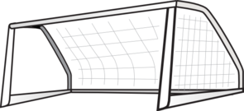
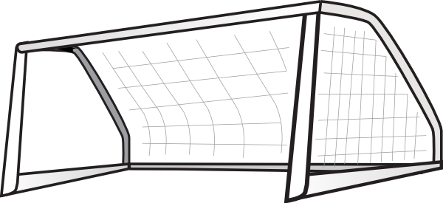
The ball is in the goal

Slide 19
The ball is in front of the goal

Slide 20
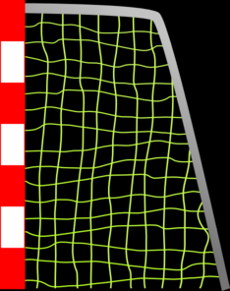
The ball is behind the goal.

Slide 21
The ball is going past the goal.

Slide 22
The ball is going over the goal

Slide 23
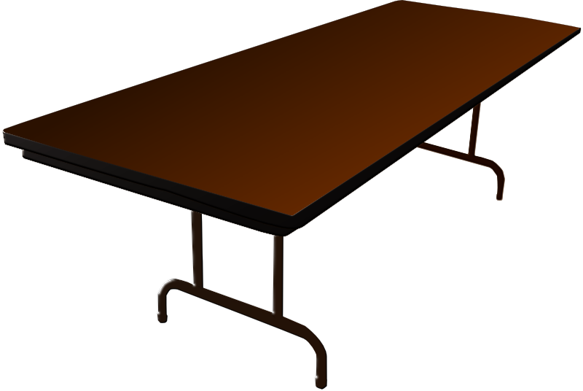
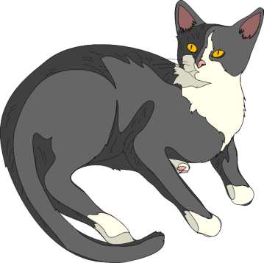
Where is the cat?
It’s under the
table.

Slide 24
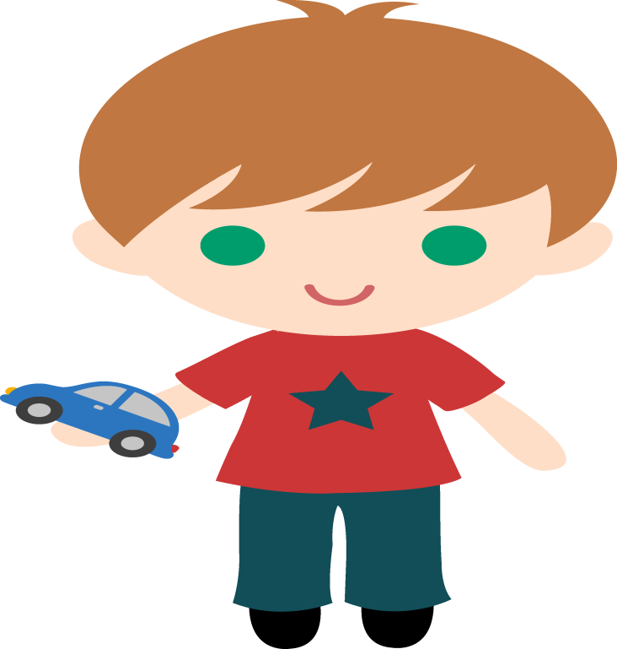
Where is the dog?
It’s behind the
boy.

Slide 25
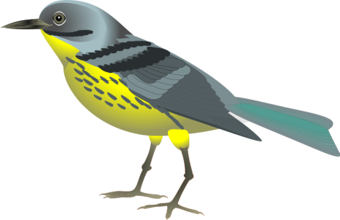
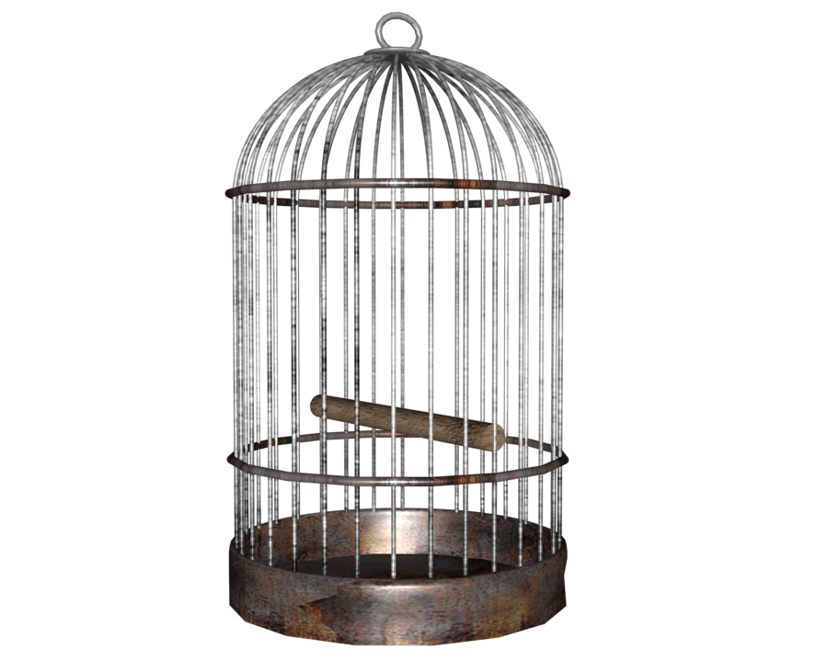
Where is the bird?
It’s on the cage.

Slide 26
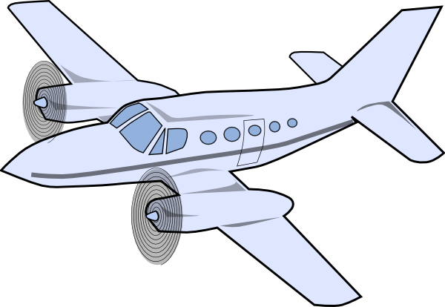
Where is the airplane?
It’s flying over the mountains.

Slide 27
Where is the ball?
It’s going through the basket.

Slide 28
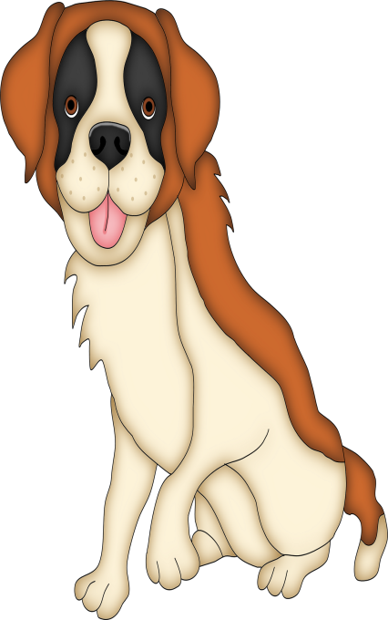
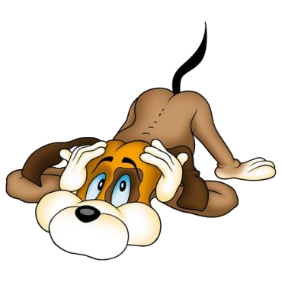
Where is the kitten?
It’s between the dogs.

Slide 29
Where is the strawberry?
It’s in front of the apple.

Slide 30
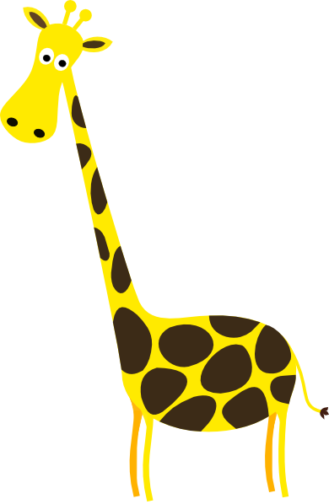
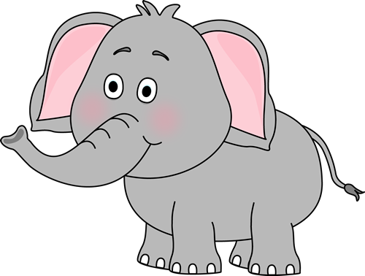
Where is the giraffe?
It’s between the elephant and the penguin.

Slide 31
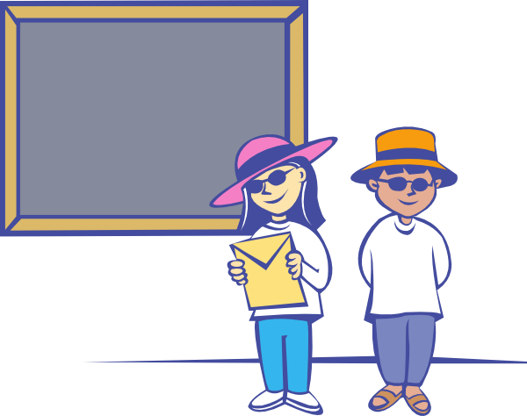
Where are the students?
They are in front of the blackboard.

Slide 32
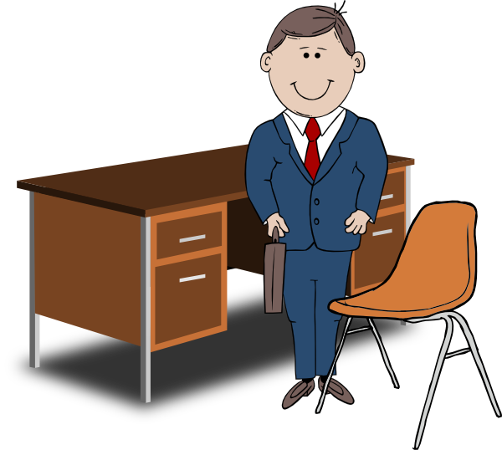
Where is the teacher?
He is between the chair and the desk.

Slide 33
Where is the owl?
It’s on the book.

Slide 34
It’s on the head.
Where is the hat?

Slide 35
It’s on the apple.
Where is the fly?

Slide 36
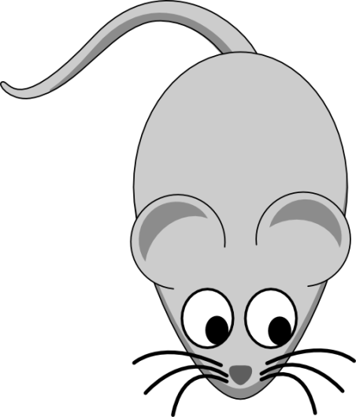
Where is the cat?
It’s opposite
the mouse.

Slide 37
Where is the owl?
It’s under
the umbrella.

Slide 38
Where is the squirrel?
It’s behind the box.

Slide 39
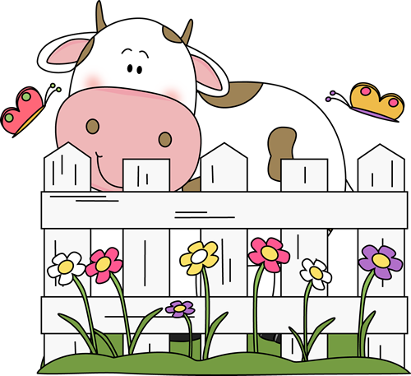
Where is the cow?
It’s behind the fence.

Slide 40
Where is the sun?
It’s behind the cloud.

Slide 41
Where are the clouds?
They are in front of the sun.

Slide 42
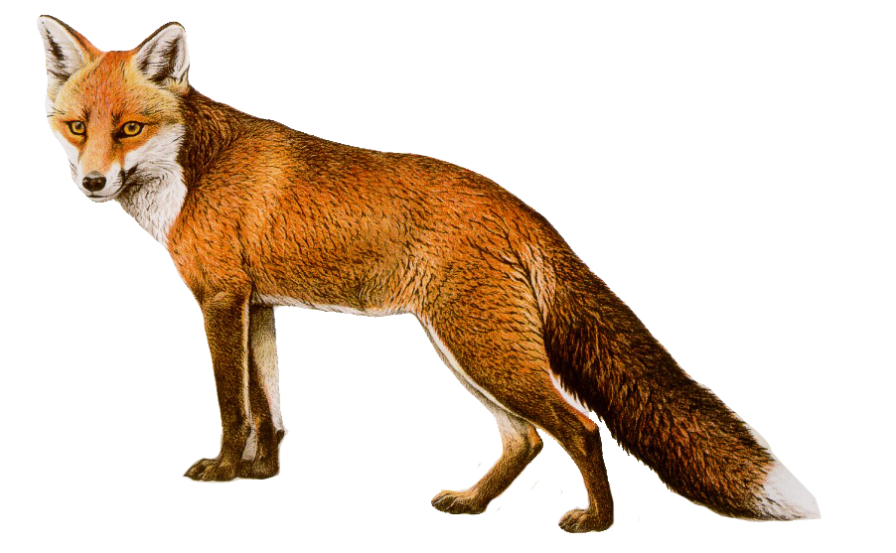
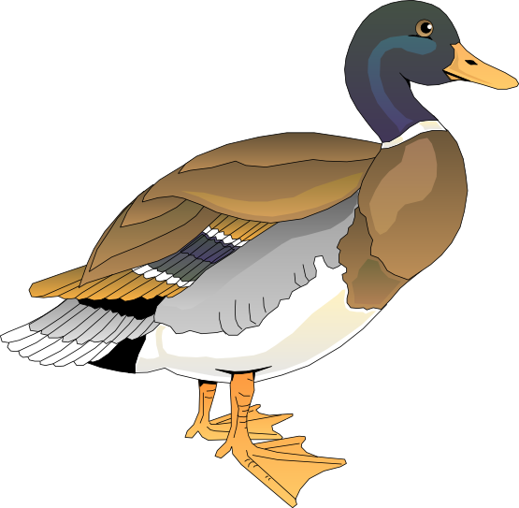
Where is the fox?
It’s opposite the duck.

Slide 43
Where is the owl?
It’s next to the mouse.

Slide 44
Where is the bird?
It’s flying over the water.

Slide 45
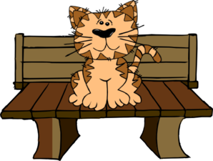
Where is the cat?
It’s on the garden seat.

Slide 46
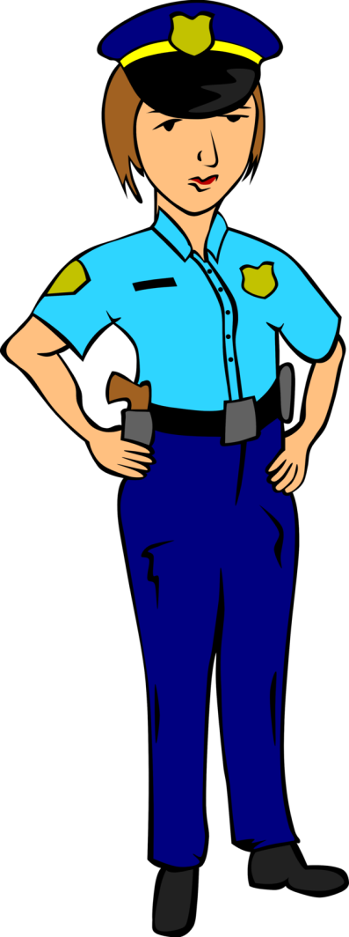
She is next to the police car.
Where is the police woman?

Slide 47
They are in the box.
Where are the books?

Slide 48
It’s in the cup.
Where is the frog?

Slide 49
It’s behind the rhino.
Where is the palm tree?

Slide 50
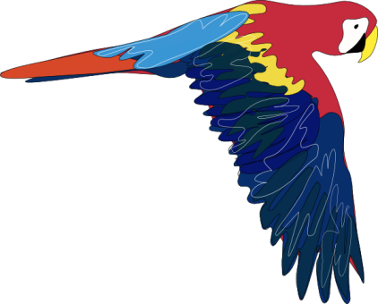
It’s flying over the houses.
Where is the parrot flying?

Slide 51
Where is the polar bear?
It’s on the ice.

Slide 52
Where is the shopping mall?
shopping mall
Bangkok Road
It’s on Bangkok Road.

Slide 53
Where is the post office?
Post Office
Amsterdam Road
It’s on Amsterdam Road.

Slide 54
Where is cinema?
cinema
restaurant
It’s next to the restaurant.

Slide 55
Manila Road
Where is the coffee shop?
cinema
coffee shop
bank
It’s between the cinema and the bank.

Slide 56
Manila Road
Where is the barber shop?
It’s on Bangkok Road.
barber
shop
B a n g k o k R o a d
It’s on the corner of Bangkok Road and
Manila Road.

Slide 57
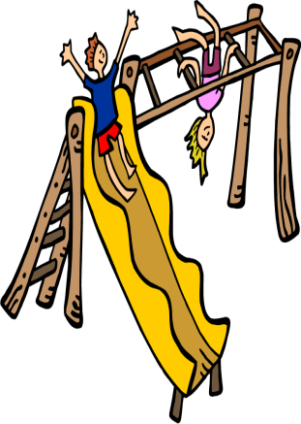
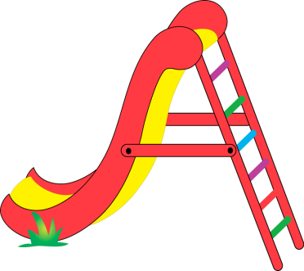
Manila Road
Museum
It’s behind the museum.
Where is the children’s playground?

Slide 58
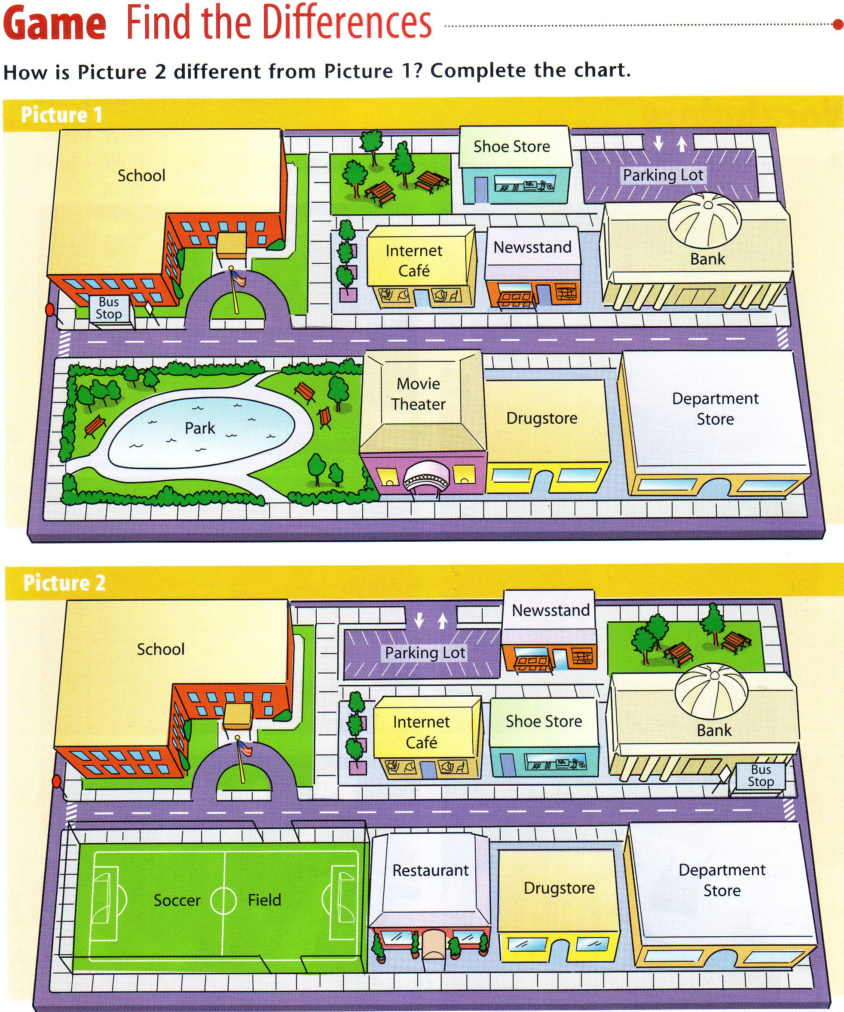
3. Shoe Store
First say where the building is located in picture 1.
Then say where the same building is located in picture 2.
Click enter to continue.
4. Internet Cafe
2. Newsstand
5. Bus stop
1. Parking lot
4. Internet Cafe
1. Parking lot
3. Shoe Stop
2. Newsstand
5. Bus stop

Slide 59
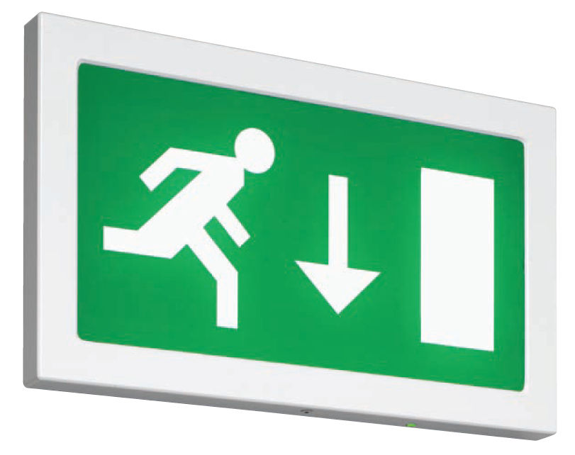
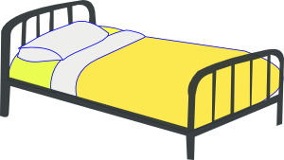
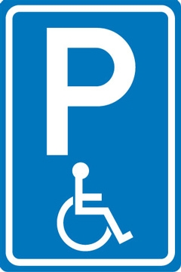
Airport

Slide 60
Post office

Slide 61
Hotel

Slide 62
Pharmacy

Slide 63
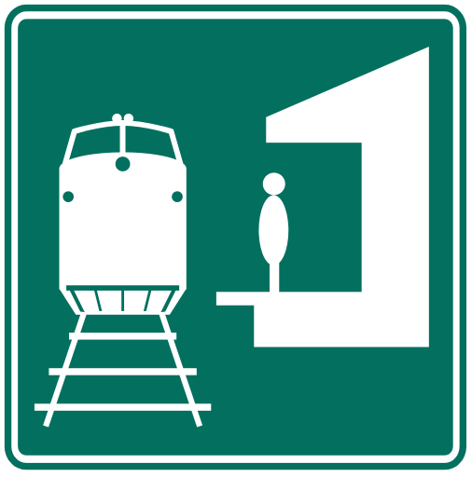
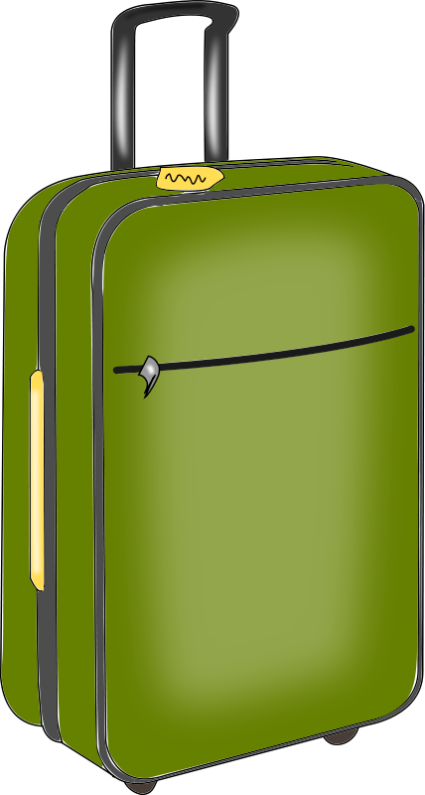
Railway station

Slide 64
Cinema

Slide 65
Restaurant

Slide 66
Temple

Slide 67
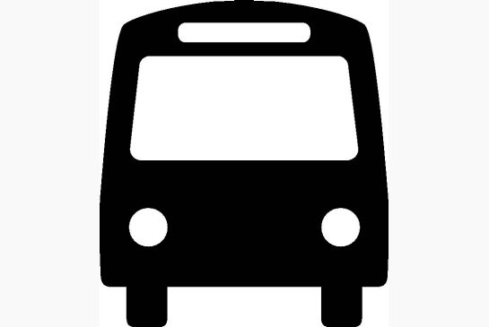
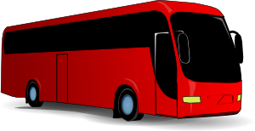
Bus stop

Slide 68
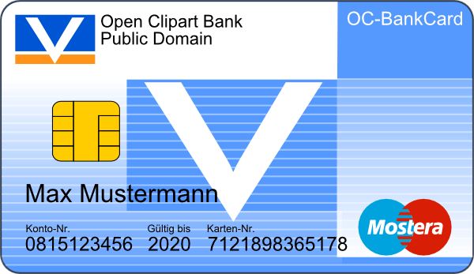
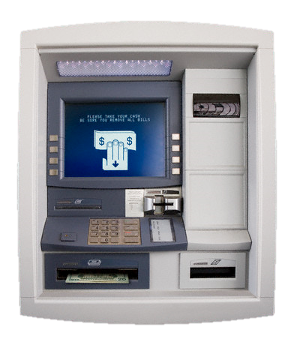
Bank and ATM machine

Slide 69
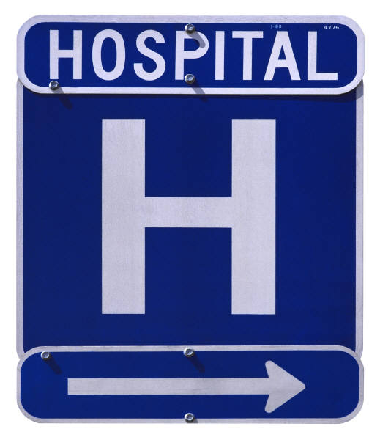
Theater
Music and Drama

Slide 70
Police office

Slide 71
Hospital

Slide 72
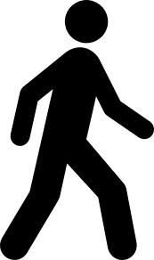
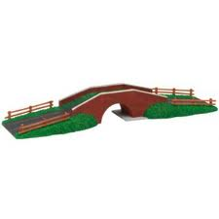
Cross the street
Cross
the intersection
Cross the bridge

Slide 73
Go straight

Slide 74
Turn right

Slide 75
Turn left..

Slide 76
third street on your left
fourth street on your right
second street on your left
third street on your right
second street on your right
first street on your left
First 1st
Second 2nd
Third 3rd
Fourth 4th
first street on your right

Slide 77
third street on your left
fourth street on your right
second street on your left
third street on your right
second street on your right
first street on your left
first street on your right

Slide 78
third street on your left
fourth street on your right
third street on your right
second street on your left
second street on your right
first street on your left
first street on your right

Slide 79
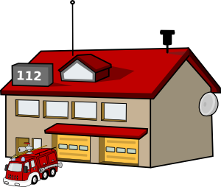
Question:
‘Excuse me.’
Could you tell me the way to the hotel please?’
school
fire station
airport
hotel
First (1)
building
on your left.
Second (2)
building
on your left.
Third (3)
building on
your left.
Fourth (4)
building on
your left.
1. ‘Go straight.’
2. ‘Take the second street on your right.’
3. ‘It’s next to the school.’
3. ‘It’s the first building on your left.’

Slide 80
Question:
‘Excuse me.’
Could you tell me the way to the fire station please?’
school
fire station
airport
hotel
First (1)
building
on your left.
Second (2)
building
on your left.
Third (3)
building on
your left.
Fourth (4)
building on
your left.
1. ‘Go straight.’
2. ‘Take the second street on your right.’
4. ‘It’s between the airport and the school.’
3. ‘It’s the third building on your left.’

Slide 81
school
fire station
hotel
airport
Question:
‘Excuse me.’
Could you tell me the way to the hotel please?’
1. ‘Go straight.’
2. ‘Take the second street on your left.’
3. ‘It’s the third building on your right’

Slide 82
Question:
‘Excuse me.’
Could you tell me the way to 7 Eleven please?’
4. ‘It’s opposite the school.’
Market Street
4. ‘It’s between the hotel and the temple.’
3. ‘It’s the second building on your right.’
2. ‘Take the third street on your left.’
1. ‘Go straight.’
.

Slide 83
Suthep Road
Suthep Road
Question:
Excuse me.
Could you tell me the way to the Kasikorn bank please?
Answer:
Go straight,
Take the second street on your right,
Cross the intersection.
It’s the second building on your left.
It’s next to the barber shop.
It’s opposite Big C.
It’s on the corner of Suthep Road and King Rama the Second Road.
King Rama the Second
You are here.

Slide 84
Suthep Road
Suthep Road
Question:
Excuse me.
Could you tell me the way to the ATM machine please?
Answer:
Go straight,
Take the second street on your right,
Turn right on the intersection.
Turn left on the next intersection.
Turn right on the junction.
It’s the 2nd building on your left
It’s opposite the bus station.
It’s between the post office and the guesthouse.
King Rama the Second
You are here.

Slide 85
Huay Kaew Road
Market Street
Suthep Road
Go straight,
Take the second street on your right,
Cross the intersection.
Turn right at the junction.
5. It’s the second building on your left.
6. It’s between the post office and the guesthouse,
7. It’s opposite the bus stop.
Canal Street
Thanon Rong Rian
Boulevard King Rama the Second
You are here.
Guesthouse
Could you tell me the way to the ATM machine please?

Slide 86
Huay Kaew Road
Market Street
Go straight,
Take the second street on your right,
Then take the first street on your right.
Then take the first street on your left.
It’s the second building on your right.
It’s next to the school.
It’s opposite 7Eleven.
Suthep Road
Thanon Rong Rian
Canal Street
Soi 2
School
Boulevard King Rama the Second
You are here.
Could you tell me the way to the fuel station please?

