Slide 1
Shapes
RAINBOW OF EDUCATION
PowerPoint Presentations

Slide 2
1. square

Slide 3
2. circle

Slide 4
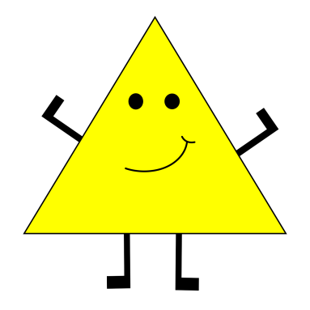
3. triangle

Slide 5
4. heart

Slide 6
5. star

Slide 7
6. rectangle

Slide 8
7. pentagon

Slide 9
8. oval

Slide 10
9. hexagon

Slide 11
Now, let’s exercise

Slide 12
2. circle

Slide 13
1. square

Slide 14
4. heart

Slide 15
5. star

Slide 16
3. triangle

Slide 17
7. pentagon

Slide 18
6. rectangle

Slide 19
8. oval

Slide 20
9. hexagon

